Slide 1

Potential usage of mathematical and in silico modeling for in-depth data analysis, treatment design and personalized medicine
Jan Poleszczuk
Laboratory of Mathematical Modeling of Physiological Processes
Nalecz Institute of Biocybernetics and Biomedical Engineering
Polish Academy Of Sciences
25th October 2018, Panzberg, Genrmany

Slide 2
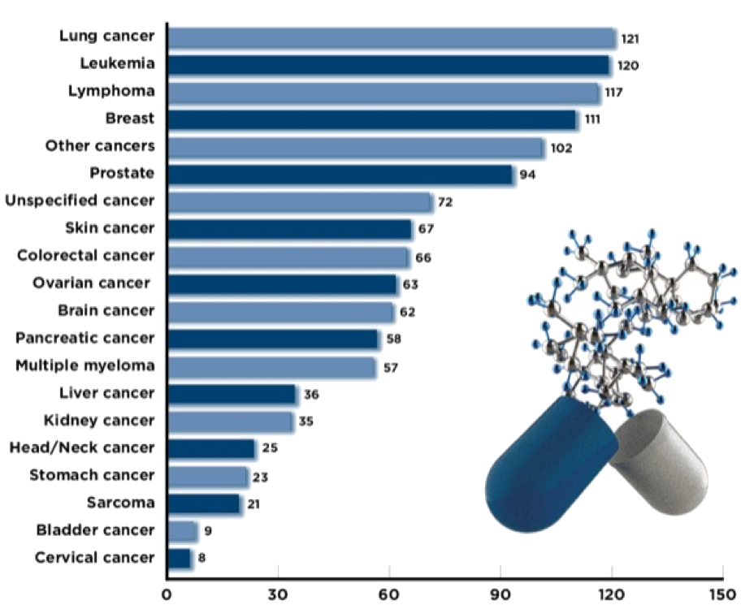
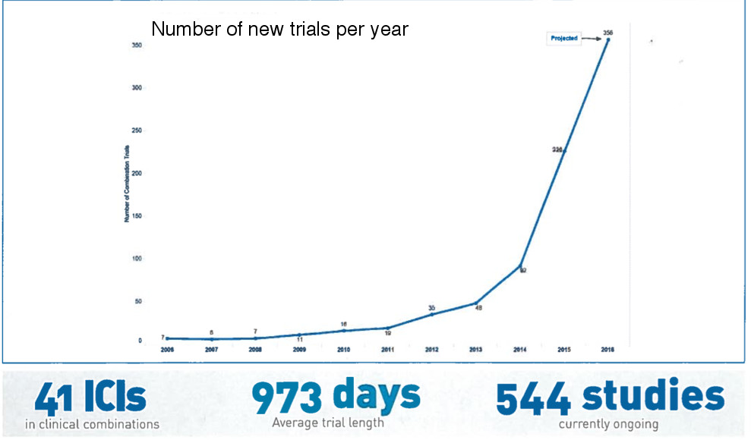
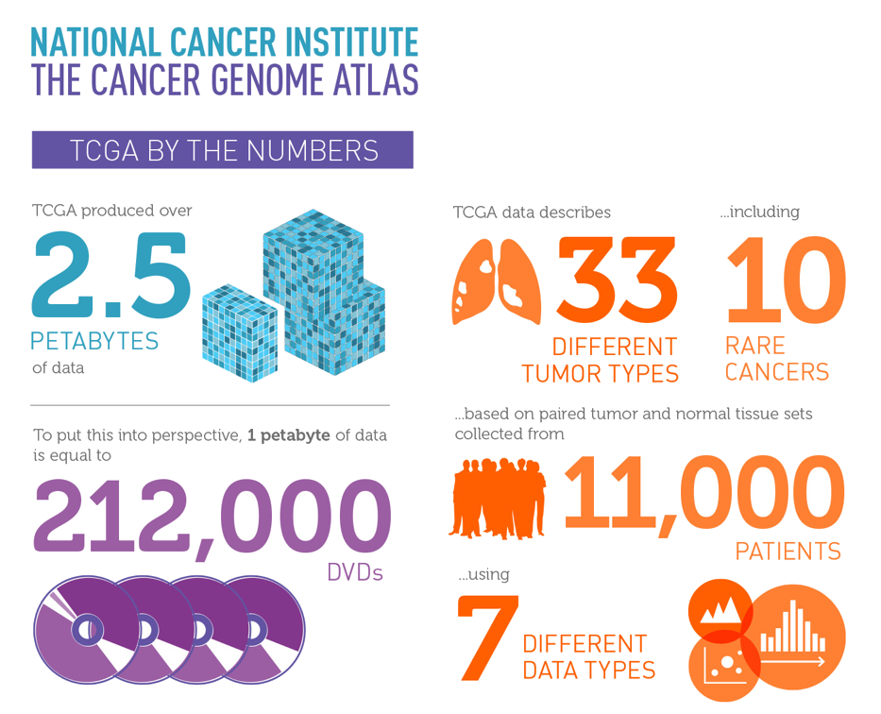
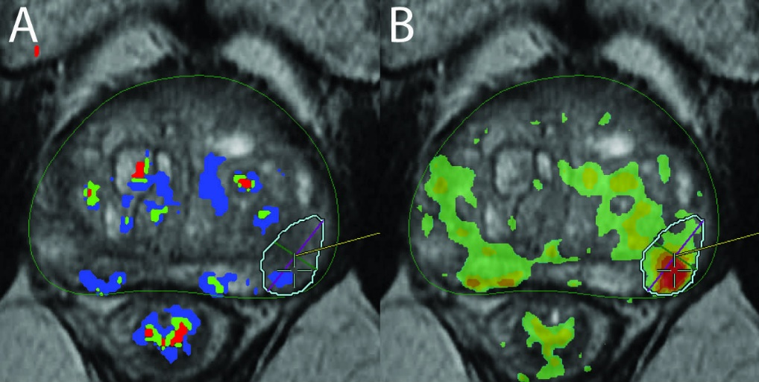
Some of the Current challenges In oncology
Increasing number of drugs (in US alone there were about 1000 drugs in testing in 2012).
Increasing number of combination therapies to test (below is the number of studies with checkpoint inhibitors in combination with other drugs in 2016).
Increasing amount of data to analyze (2.5 petabytes in The Cancer Genome Atlas alone).
Increasing number of new diagnostic tools that need to be thoroughly validated.

Slide 3
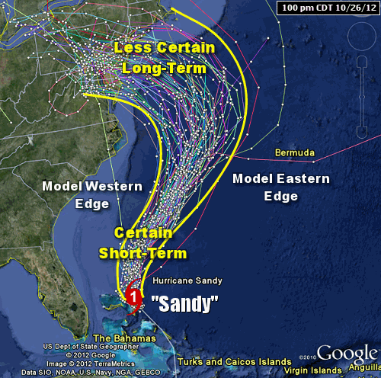
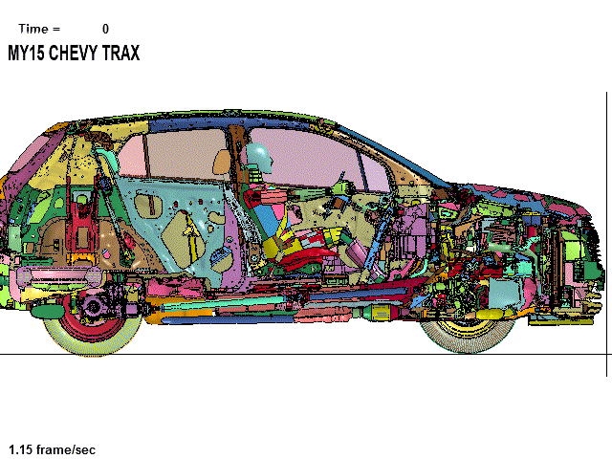
Integrated mathematical oncology
Utilize mathematical and computational tools to create framework(s) for virtual clinical trials and novel predictive models for oncology.
General Motors Chevy Trax virtual crash test.
US Dept. Of State Geographer, ©2012 Google, Image ©2012 TerraMetrics, Data SIO, NOAA, U.S. Nawy, NGA, GEBCO

Slide 4
Immunotherapy screening using in silico models
There are many possible ways to combine immunotherapy with other treatments.
Can we develop in silico models to (pre)screen possible combinations?

Slide 5
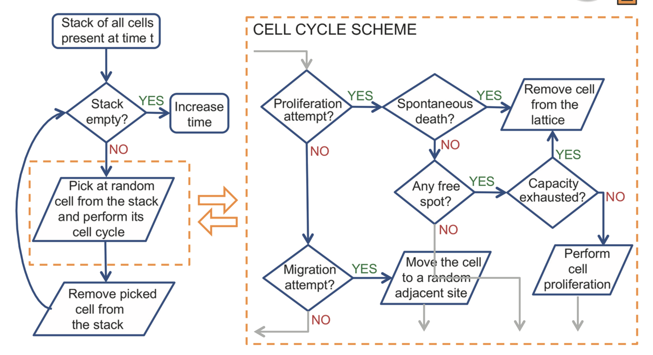

Agent-based modeling
On-grid agent-based model
Moore neighborhood
15 $μm$
Poleszczuk et al., Plos Comp Biol, 2015
Notes:
Make consistent article numbering

Slide 6
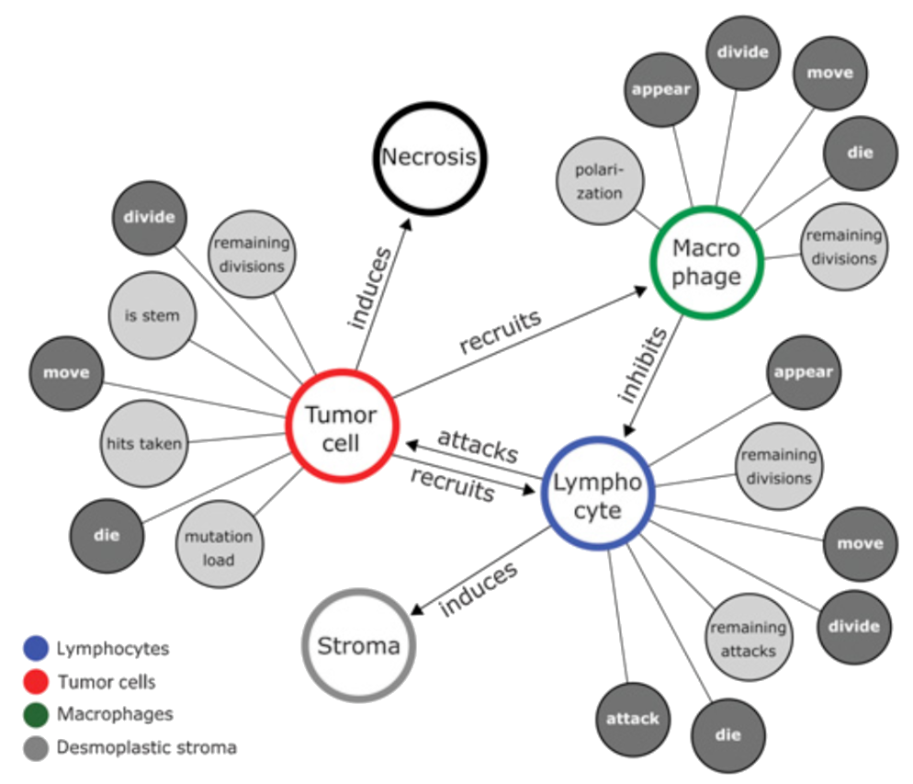
Incorporating AGENTS AND Interactions network
Kather, Poleszczuk, et al., Cancer Res, 2018
Notes:
Make consistent article numbering

Slide 7
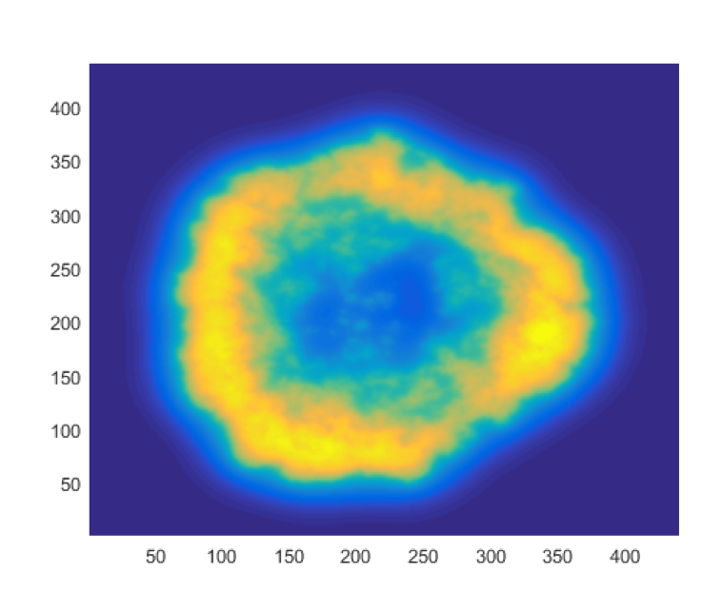
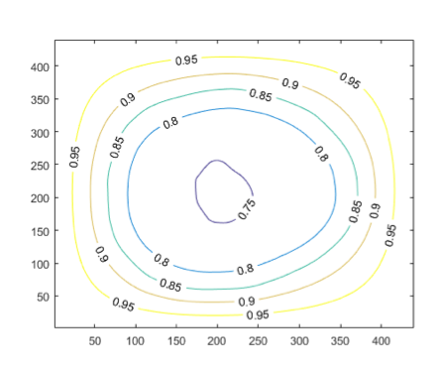
Fusion WITH GRADIENTS OF VARIOUS factors
Chemotactic signals
Nutrients availability
Kather, Poleszczuk, et al., Cancer Res, 2018

Slide 8
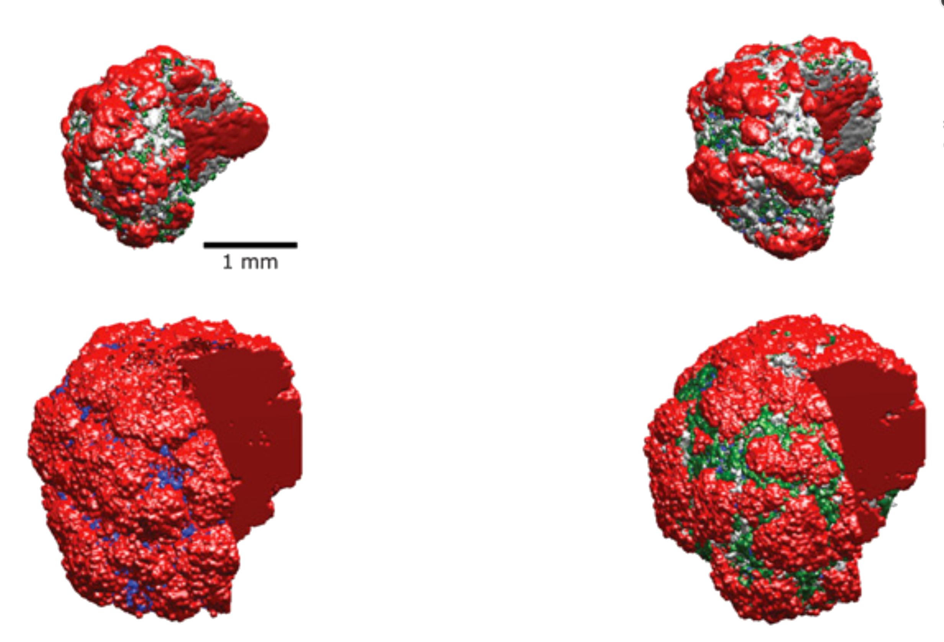
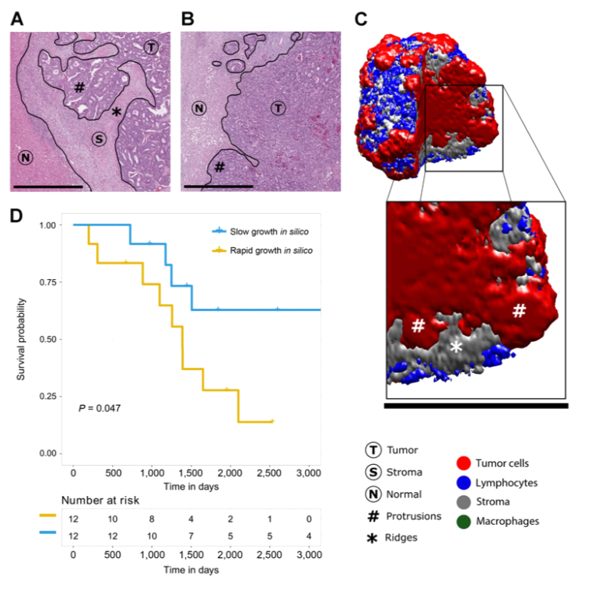
Exemplary simulations
The model is capable of simulating various clinically observed tumor compositions.
Tumor cells
Lymphocytes
Stroma
Macrophages
Kather, Poleszczuk, et al., Cancer Res, 2018

Slide 9
Exemplary simulations
Realistic spatial distributions.
Tumor
Tumor cells
Stroma
Lymphocytes
Normal
Stroma
Protrusions
Macrophages
Ridges
Kather, Poleszczuk, et al., Cancer Res, 2018

Slide 10
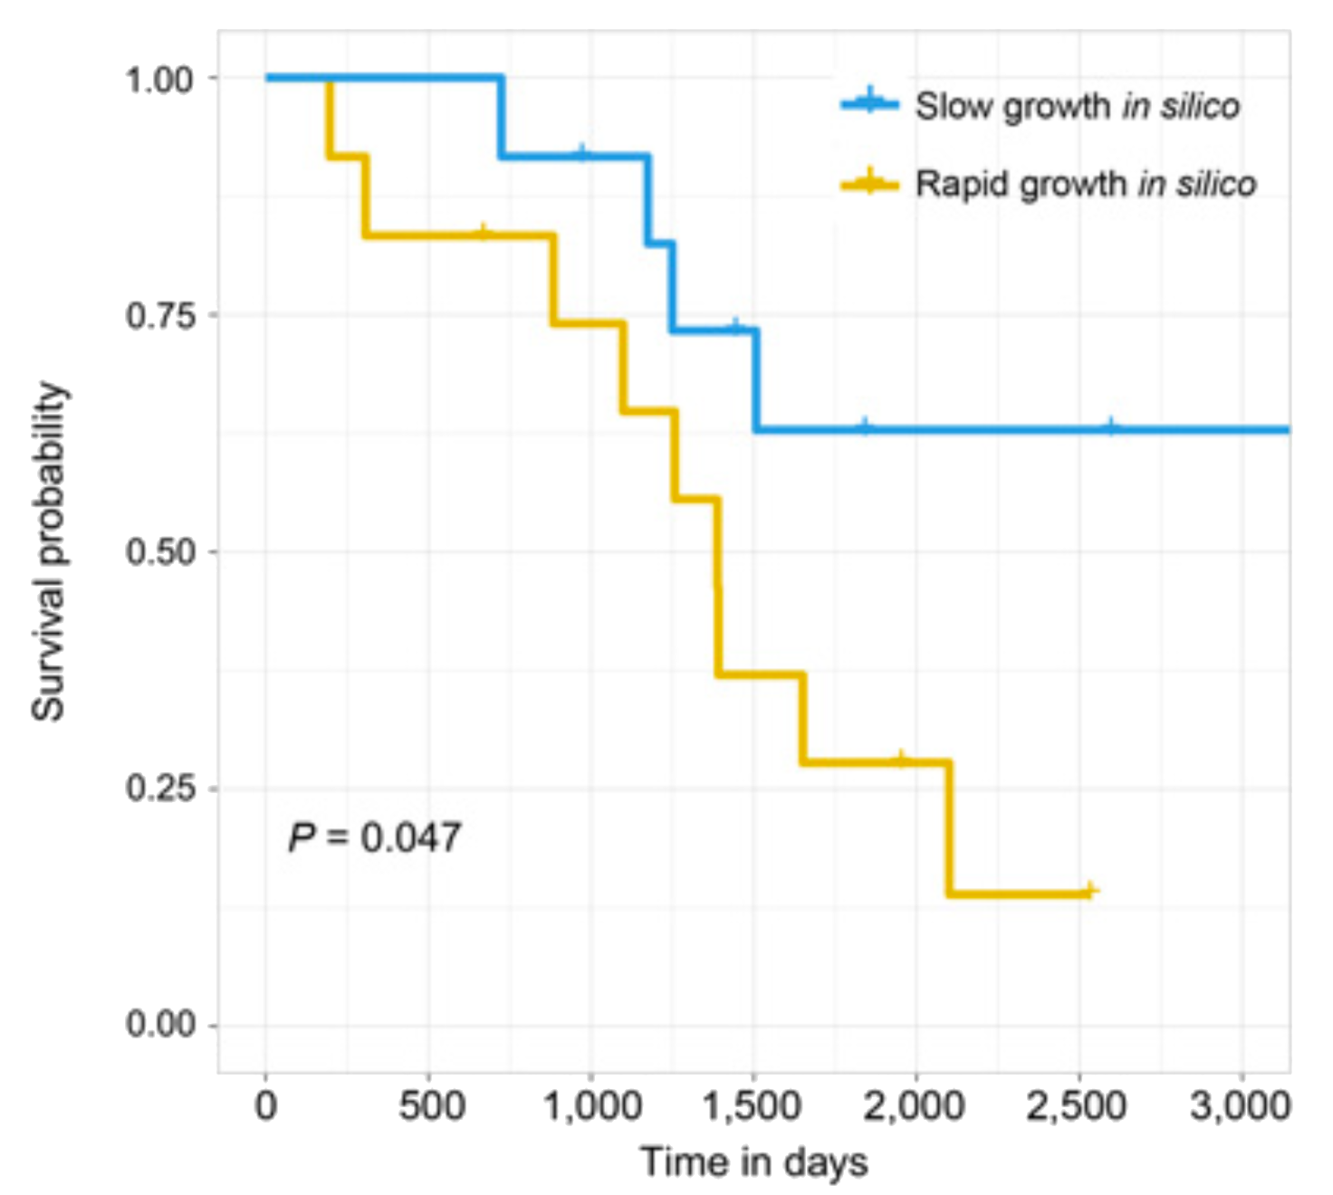
Calibrating with patient-specific data
The model can be calibrated with patient-specific data, such as histopathology.
Patients can be stratified based on the model-predicted tumor growth speed.
Kather, Poleszczuk, et al., Cancer Res, 2018

Slide 11
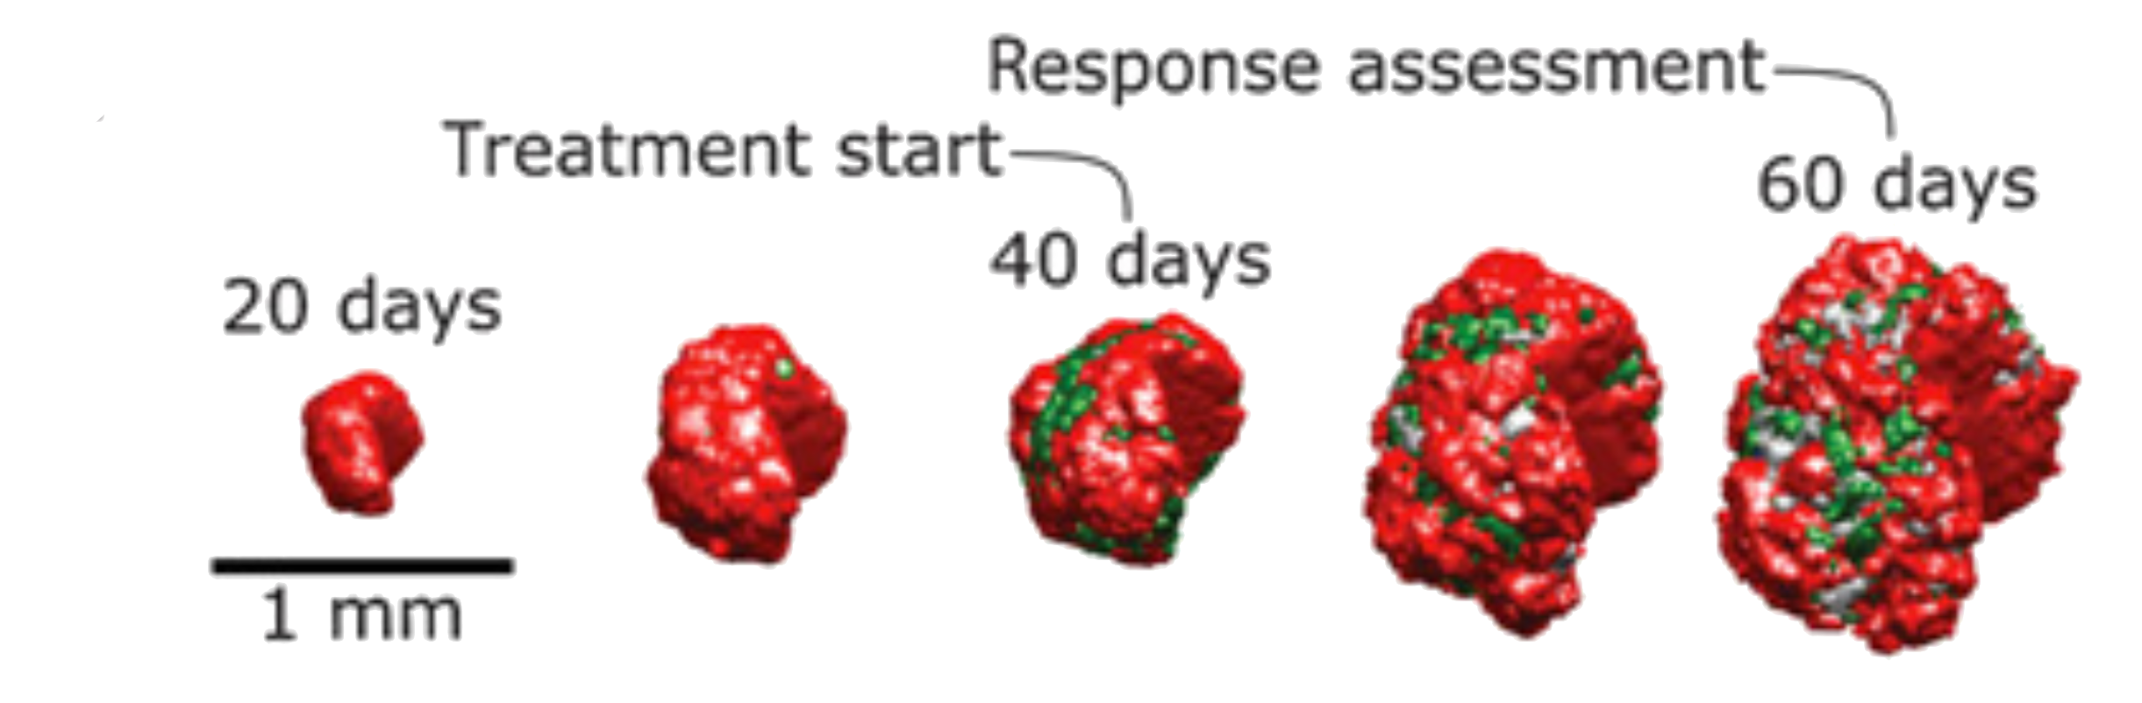
Therapy screening
After calibration with patient-specific data the model allows to quickly screen various drugs combinations.
Kather, Poleszczuk, et al., Cancer Res, 2018

Slide 12
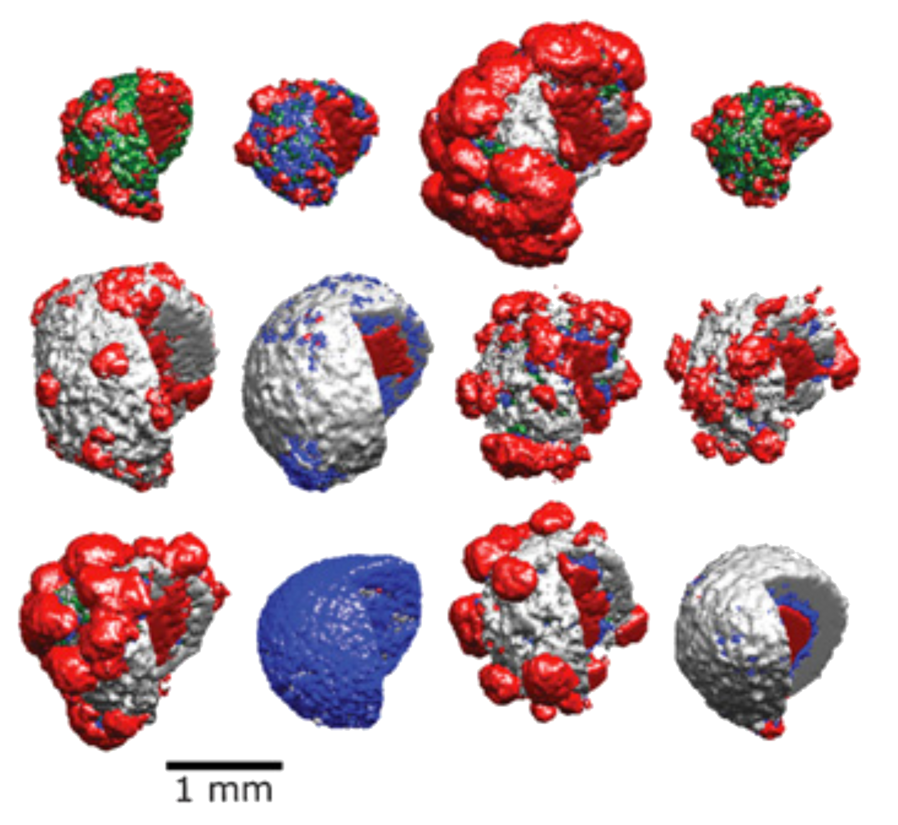
Therapy screening
Exemplary responses to various drug combinations.
Kather, Poleszczuk, et al., Cancer Res, 2018

Slide 13
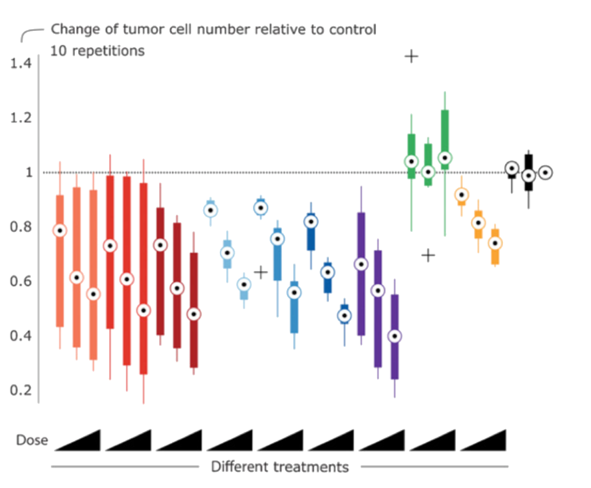
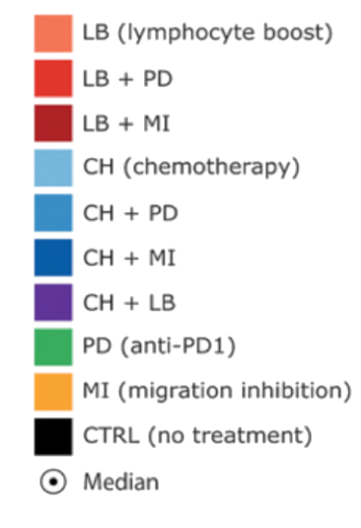
Exemplary systematic SCREENING RESULTS
Kather, Poleszczuk, et al., Cancer Res, 2018

Slide 14
Biopsy sampling problem
Previous model has been calibrated using resected tumor tissue.
Can we use biopsy samples?

Slide 15
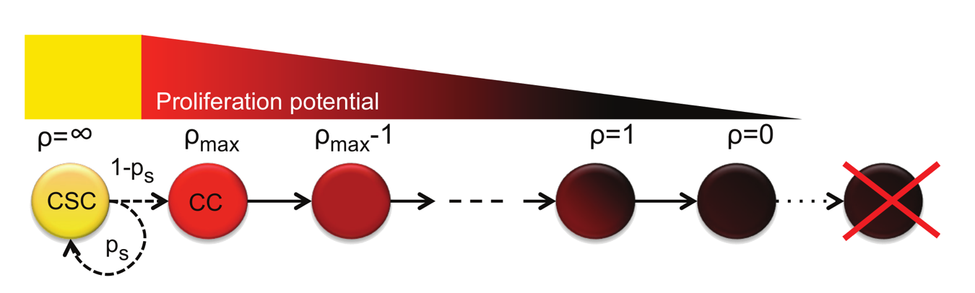
SINGLE POPULATION OF CANCER CELLS
Non-stem cancer cells have a limited proliferation capacity that is being reduced at each proliferation event.
CC dies after exhaustion of proliferation potential.
Poleszczuk et al., Plos Comp Biol, 2015

Slide 16
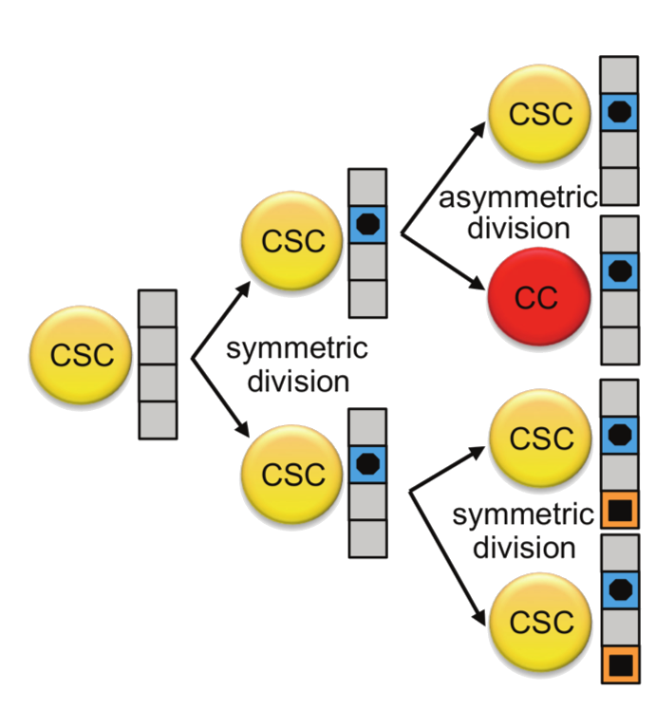
Mutations
Mutation events in the malignant subpopulation of CSCs occur during symmetric division.
Single mutation affects at most one trait and induces a stochastic positive or negative change.
Poleszczuk et al., Plos Comp Biol, 2015

Slide 17
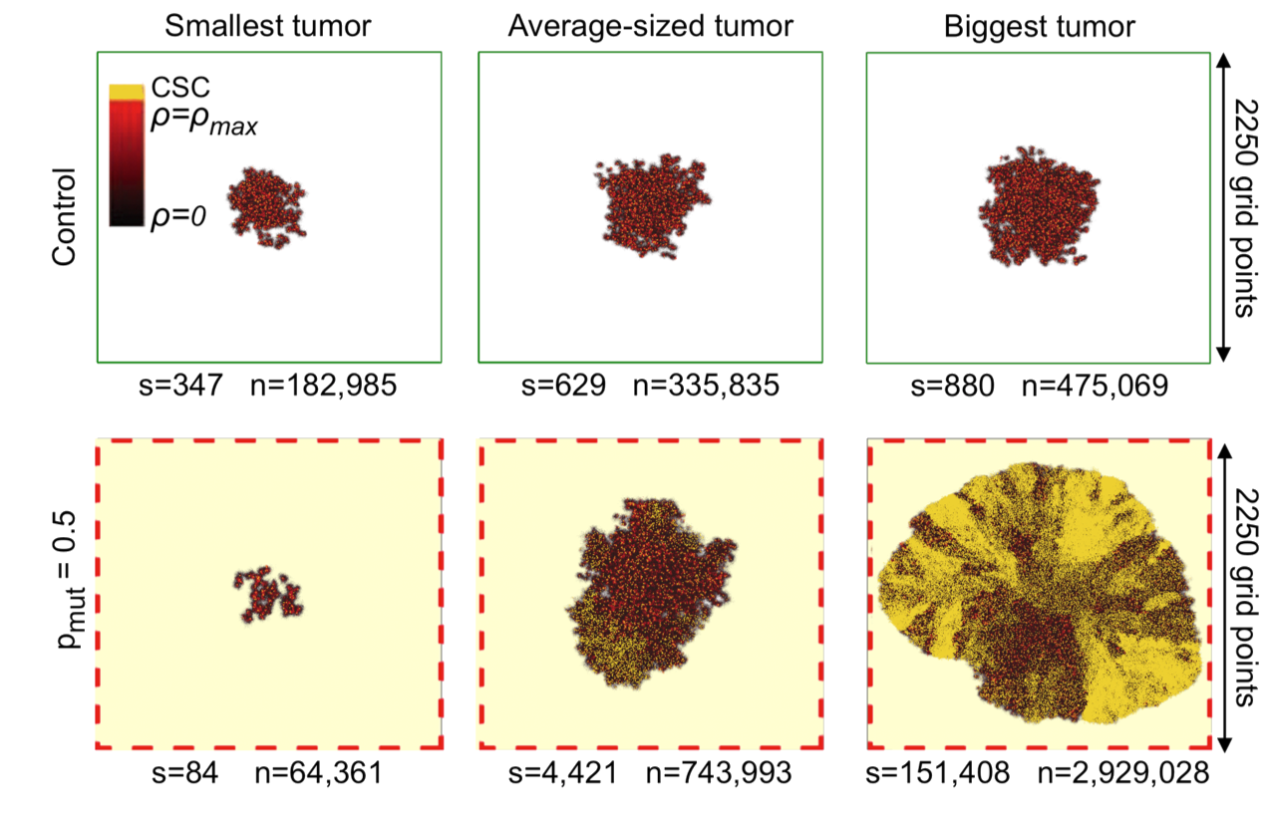
Smallest, average and the biggest tumors
Unfavorable evolution
Poleszczuk et al., Plos Comp Biol, 2015

Slide 18
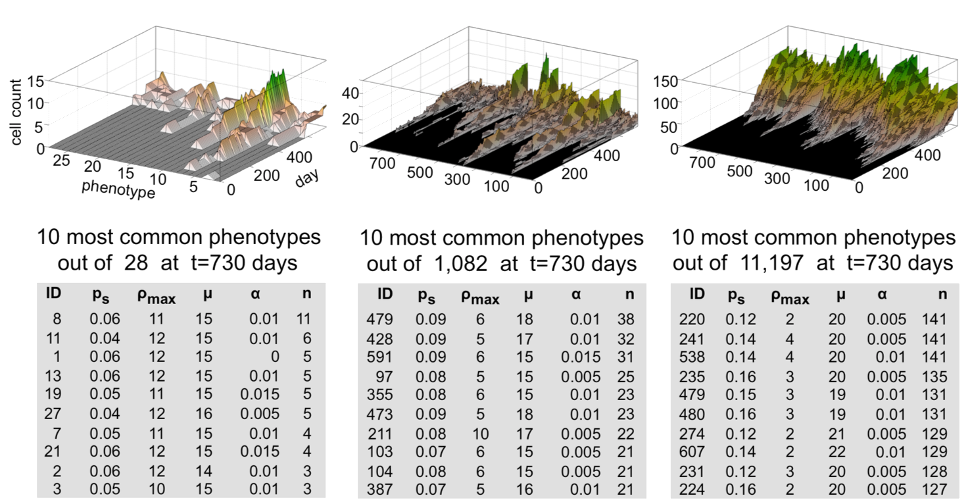
Most common phenotypes
Smallest tumor
Average-sized tumor
Biggest tumor
Poleszczuk et al., Plos Comp Biol, 2015

Slide 19
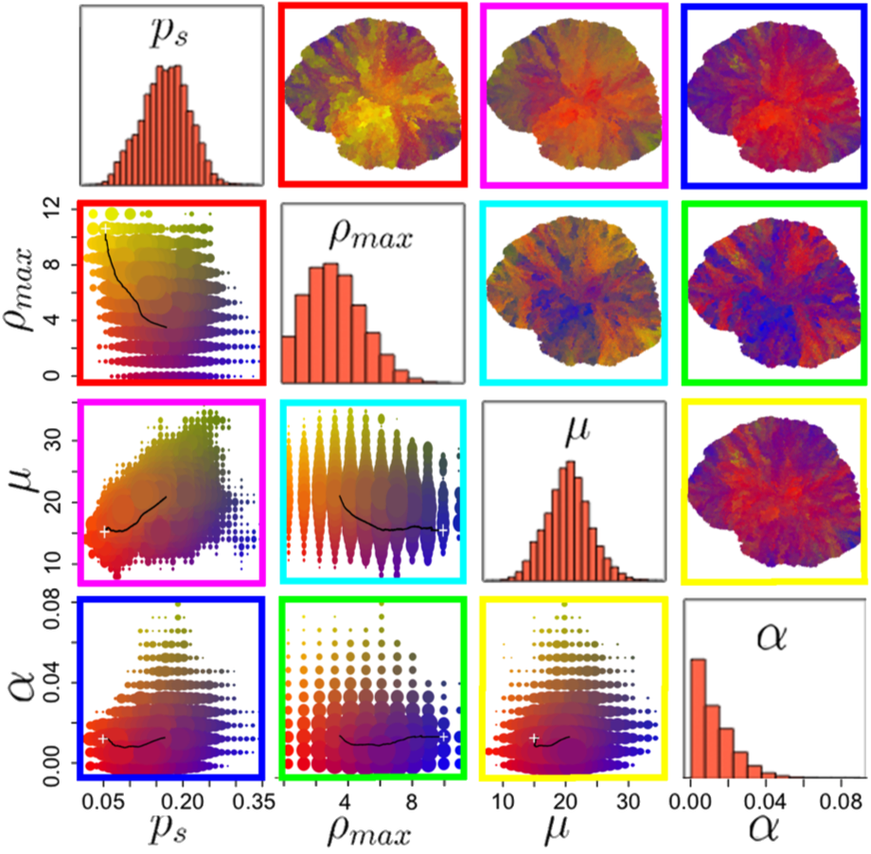
Spatial distribution of phenotypes
Evolutionary phenotypic heterogeneity leads to unpredictable spatiotemporal distribution of cells with varying aggressiveness.
Poleszczuk et al., Plos Comp Biol, 2015

Slide 20
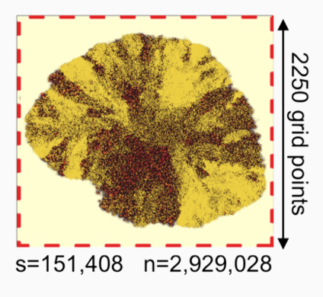
In silico biopsy
We investigate phenotypic diversity in the biopsy sample from the largest evolved tumor.
A 26 Gauge biopsy needle with a 0.46 mm diameter is simulated to penetrate the tumor from the boundary to the center of mass.
All cells (~100,000) in the needle trajectory are collected in a single harvest and their phenotypic traits averaged.
Biopsies are collected at different angles in 5 degrees intervals yielding 72 samples.

Slide 21
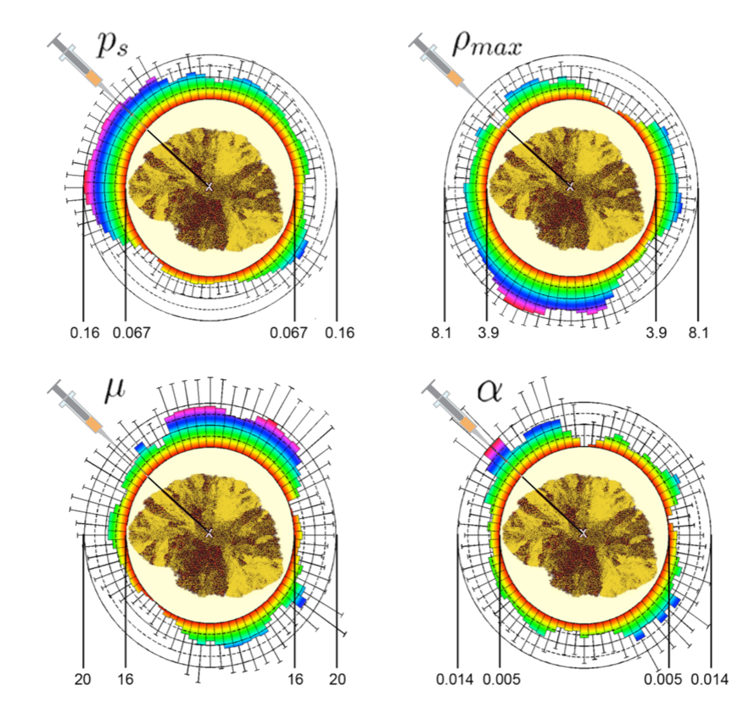
Angle dependent traits statistics
The average value for different phenotypic traits can vary orders of magnitude depending on the biopsy angle.
Poleszczuk et al., Plos Comp Biol, 2015

Slide 22
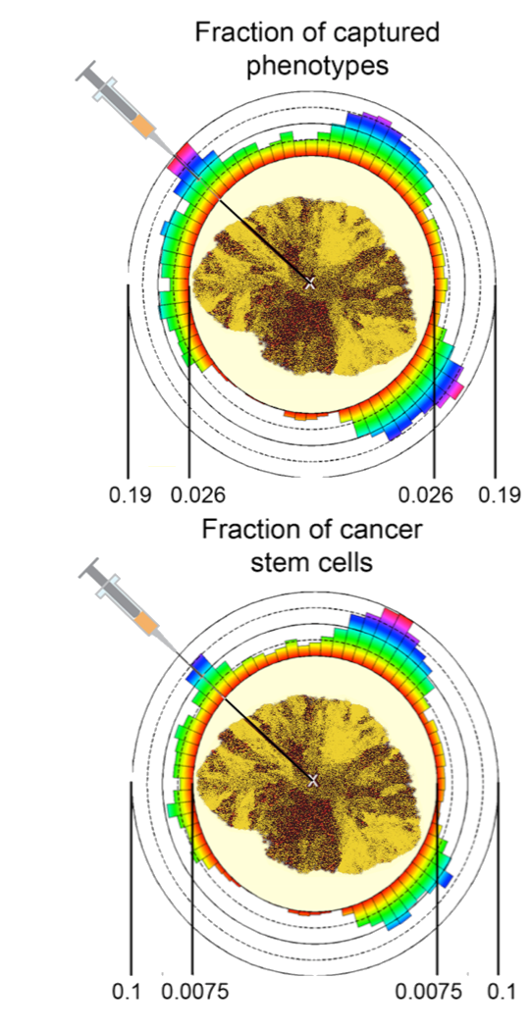
Angle dependent PHENTOYPE COVARAGE
Fraction of captured phenotypes (unique phenotypes in a sample/number of unique phenotypes in the whole tumor) varies by one order of magnitude.
Fraction of cancer stem cells in the collected samples vary by as much as two orders of magnitude ranging from 0.7% to 10%
Poleszczuk et al., Plos Comp Biol, 2015

Slide 23
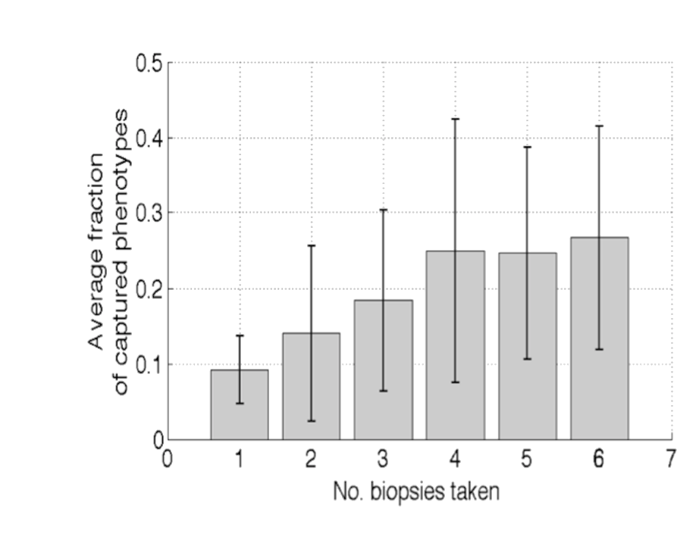
Increasing biopsy number
Multiple equally distant biopsies within a 90-degrees tumor quadrant increase the average fraction of captured phenotypes from about 9% for one biopsy to 25% for 4 or more biopsies
Poleszczuk et al., Plos Comp Biol, 2015

Slide 24
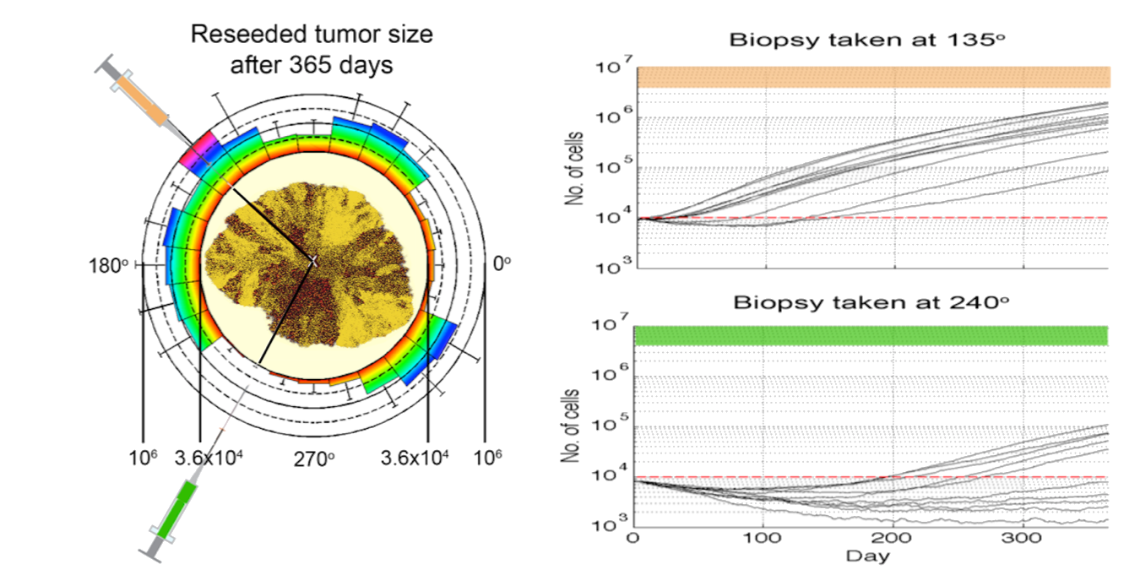
Biopsy specific growth dynamics
Biopsy-specific phenotypic diversity yields tumor populations with grossly different growth dynamics from rapid and persistent growth (for biopsy taken at 135°) to initial decay and long-term dormancy (for biopsy taken at 240°).
Poleszczuk et al., Plos Comp Biol, 2015

Slide 25
Making sense of longitudinal data
Can we use longitudinal data in combination with mathematical models to make patient-specific predictions?

Slide 26
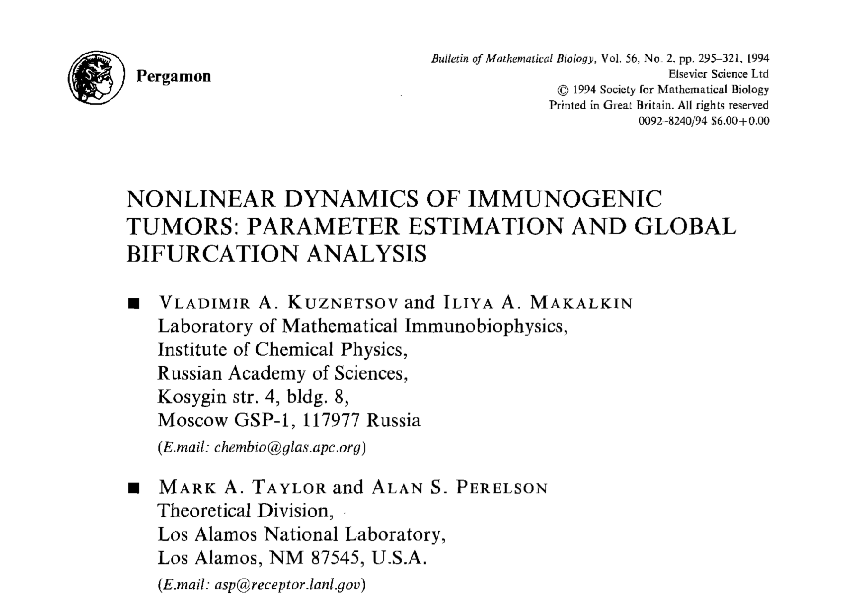
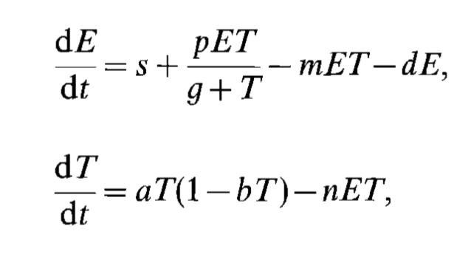
Dynamical model of tumor-immune system interactions
Kuznetsov et al., Bull Math Biol, 1994
Effector cells
Tumor cells

Slide 27
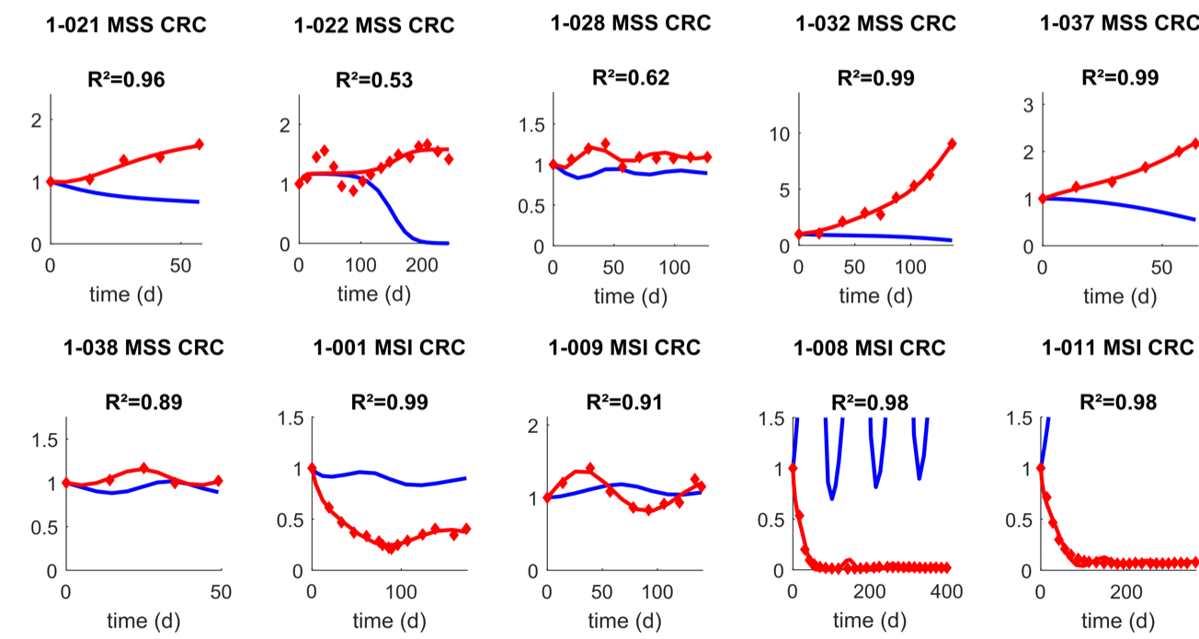
Fitting to historical data
Data from: Le DT, et al., N Engl J Med, 2015.

Slide 28
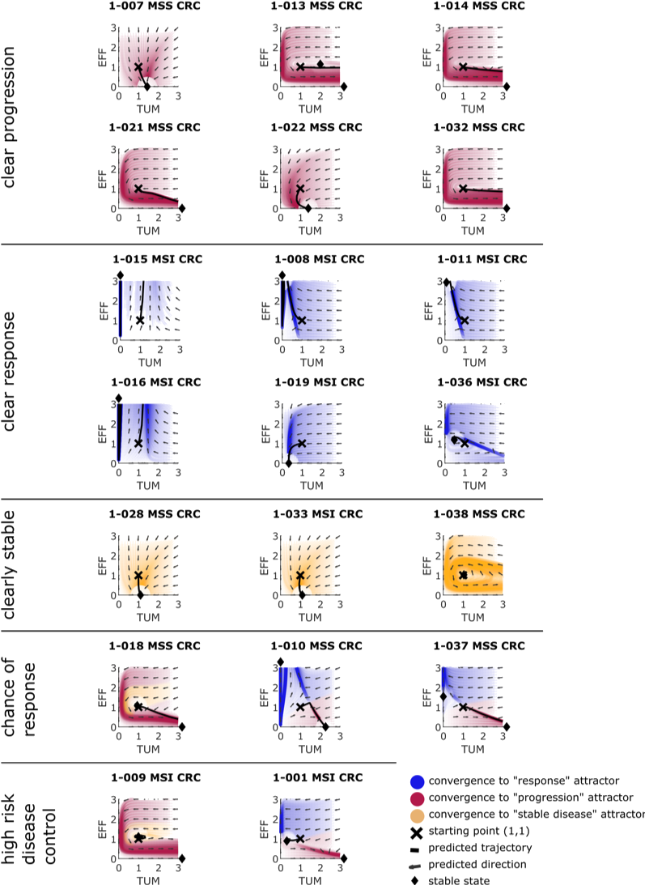
Clear progression

Slide 29
Clear Response

Slide 30
Clearly stable

Slide 31
Chance for response and high risk control

Slide 32
Enhancing radiation-induced abscopal effects with immunotherapy
What should be the radiotherapy dosage and fractionation to maximize the abscopal effect?

Slide 33
Synergy of radiation and immunotherapy
Adapted from Demaria, Int J Radiat Oncol Biol Phys, 2004

Slide 34
Radiation-induced immune system activation
Poleszczuk et al., Cancer Res, 2016

Slide 35
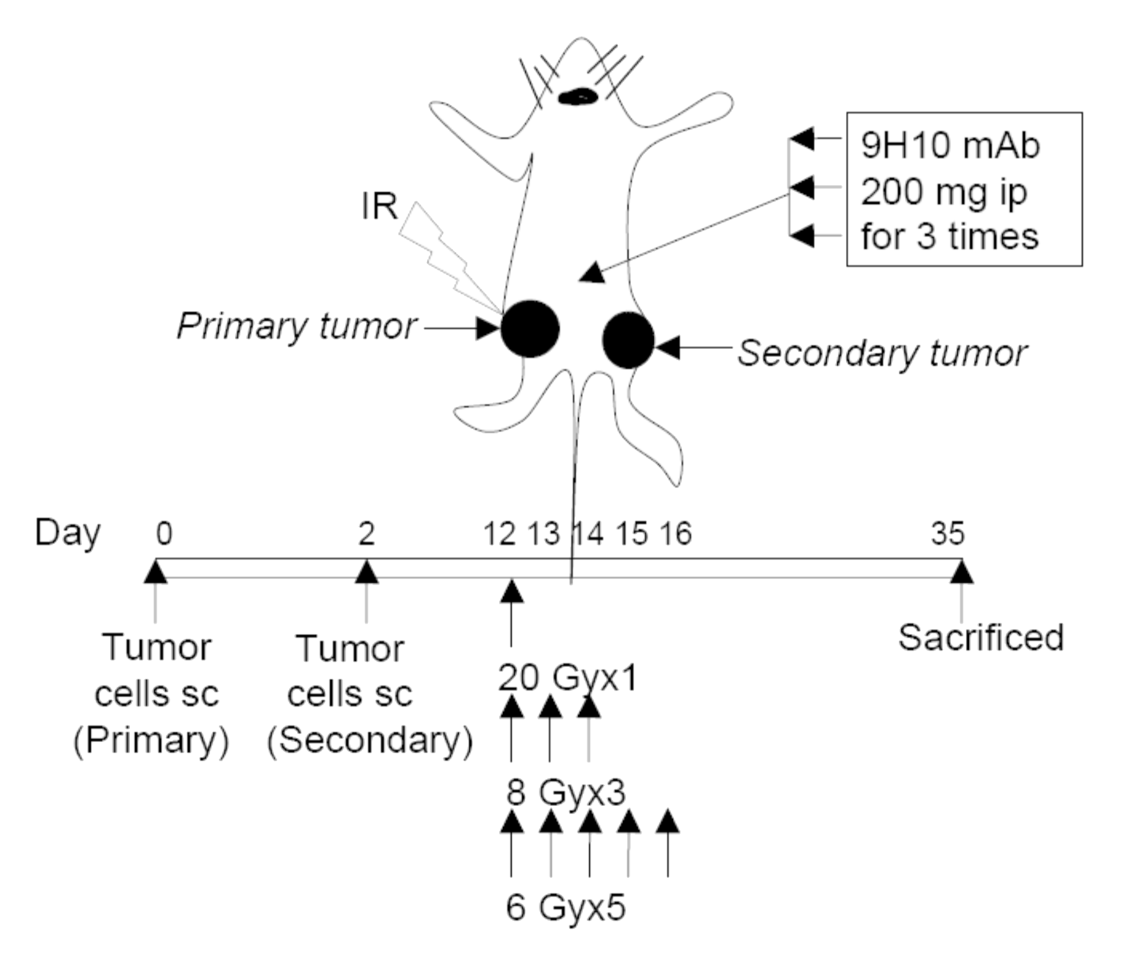
Existing experimental setting
Dewan et al., Clin Cancer Res, 2009

Slide 36
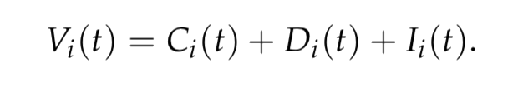
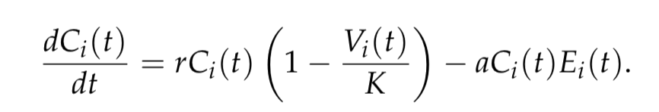
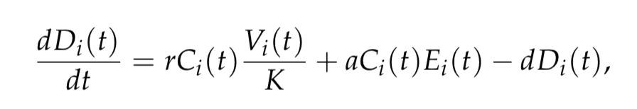
Model equations
Four interacting populations:
viable cancer cells (volume C_{i}(t) mm³);
cancer cells dying in a non-immunogenic manner (volume D_{i}(t) mm³);
cancer cells dying in immunogenic manner (volume I_{i}(t) mm³) and
activated tumor-specific cytotoxic T cells (effector cells; density E_{i}(t) cells/mm³).
Overall tumor volume (assuming negligible contribution of much smaller effector cells):
Cancer cell population dynamics at each site:
Cells dying in non-immunogenic manner:

Slide 37
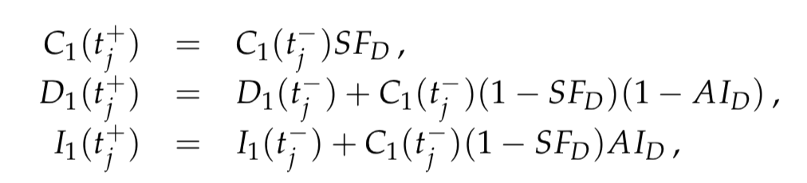
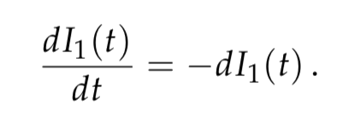
Model equations
Four interacting populations:
viable cancer cells (volume C_{i}(t) mm³);
cancer cells dying in a non-immunogenic manner (volume D_{i}(t) mm³);
cancer cells dying in immunogenic manner (volume I_{i}(t) mm³) and
activated tumor-specific cytotoxic T cells (effector cells; density E_{i}(t) cells/mm³).
Impact of radiation (only one site):
Cells dying in immunogenic manner are being cleared:

Slide 38
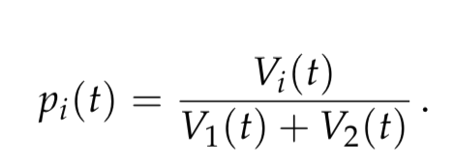
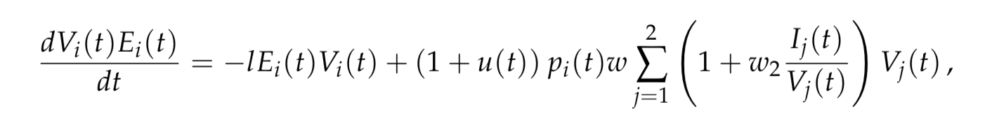
Model equations
Four interacting populations:
viable cancer cells (volume C_{i}(t) mm³);
cancer cells dying in a non-immunogenic manner (volume D_{i}(t) mm³);
cancer cells dying in immunogenic manner (volume I_{i}(t) mm³) and
activated tumor-specific cytotoxic T cells (effector cells; density E_{i}(t) cells/mm³).
Effector cells are being redistributed according to our previous model:
Effector cells dynamics:
Impact of immunotherapy
Contribution of immunogenic cell death

Slide 39
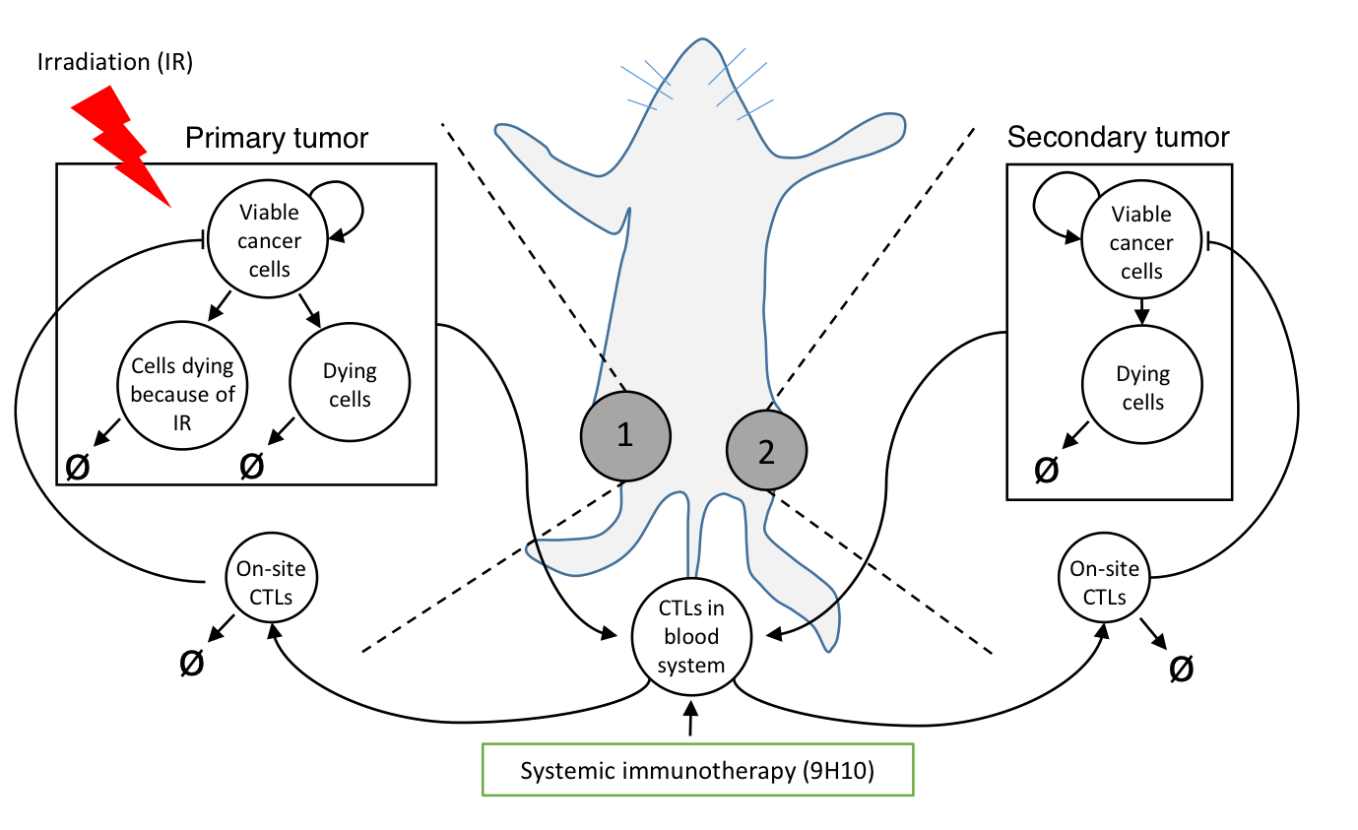
Graphical Recap

Slide 40
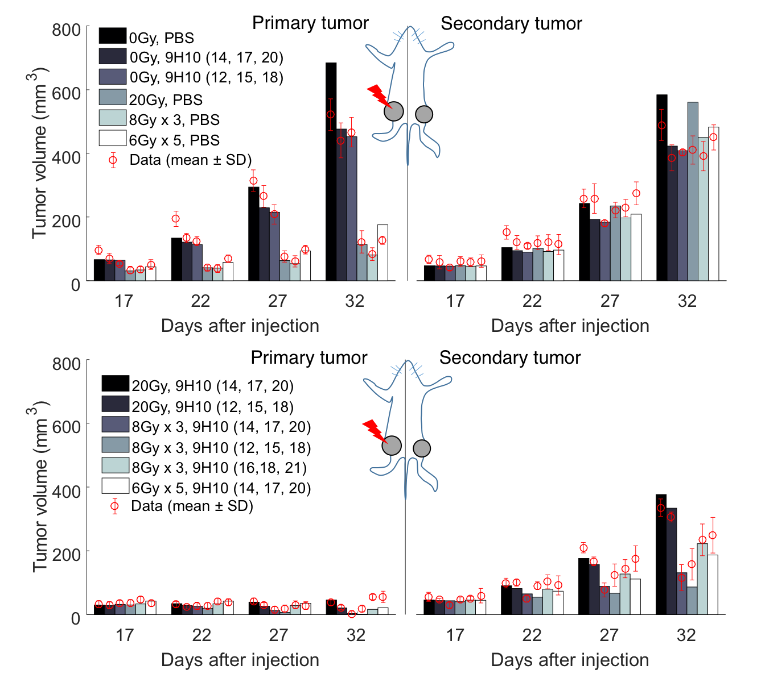
Comparison with data (after parameter estimation)
Monotherapies

Slide 41
Comparison with data (after parameter estimation)
Combination therapies

Slide 42
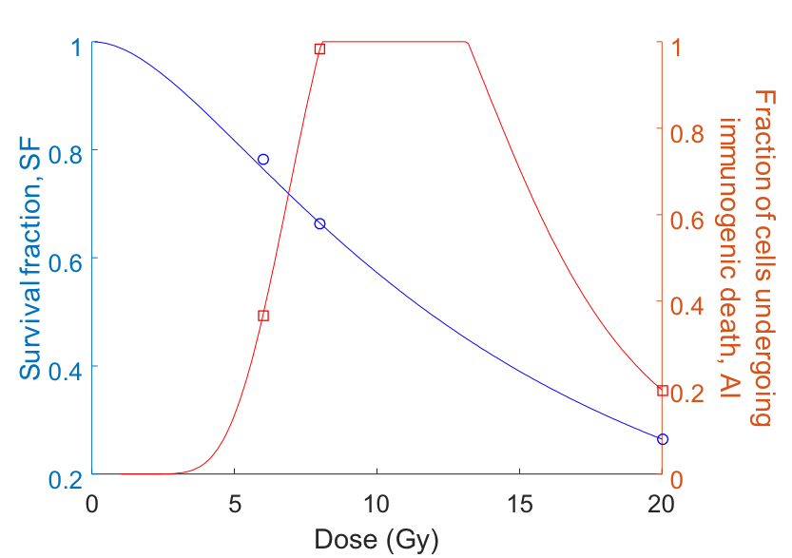
Effect Extrapolation

Slide 43
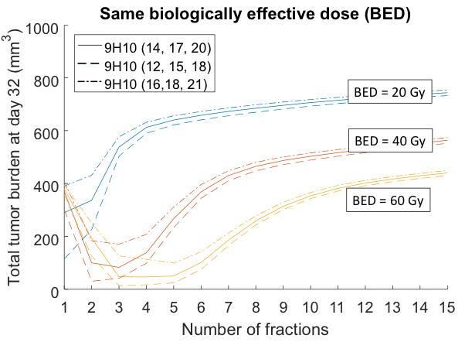
Improved therapy design

Slide 44
Summary
In silico models can be (potentially) used to predict patient’s response to various therapies.
In silico screening of various combination therapies on a per-patient basis.
Analysis of longitudinal data using mechanistic dynamical models can serve as an online clinical decision support system.
We can combine preclinical data and mechanistic models to augment clinical trial design.

Slide 45



Acknowledgments
Jakob Kather
Niels Halama
Heiko Enderling
Philip Hahnfeldt
Enderling lab

Slide 46
Thank you for your attention!
Questions?

